Slide 1

JSON vs Protocol Buffers in Microservice Serialization
Lucas Vilar & Bernardo Ventura
Assignment #1 – Data Representation & Serialization Formats
Integração de Sistemas
Mestrado em Engenharia Informática, Universidade de Coimbra

Slide 2
Hypothesis & Metrics
Hypothesis
In a local microservices setting, for small message sizes, the structural encoding overhead of Protocol Buffers may outweigh its compactness benefits, allowing JSON to achieve lower end-to-end latency
Metrics Measured
Serialization time: Object → serialized format
Deserialization time: Serialized format → object
End-to-end latency: Serialize + transmit + deserialize
Message size
Transmission was simulated by copying the byte array

Slide 3
Experiment Setup
Implementation
Language: Java
Libraries:
Jackson for JSON
Google Protocol Buffers
Data model
Product
id: String
name: String
price: double
category: String
stockQuantity: int

Slide 4
Experiment Setup
Payload sizes
Small: 5 products
Medium: 100 products
Large: 10,000 products
Iterations per trial
Small: 1,000,000
Medium: 10,000
Large: 1,000
Trials
10 trials per format and payload size
Additional details
Each trial starts with a warmup phase using the same number of iterations as the main trial to let the JVM JIT optimize the code (the effect of this warmup will be shown in the upcoming slides)
Iteration counts per payload size were chosen to balance measurement accuracy and total runtime

Slide 5
Benchmark Runs Overview
We performed the benchmark 3 times to test reproducibility and explore slightly different configurations
Table: Benchmark Run Configurations
Full results for this run and the other runs can be found in the final slides of the presentation
Run | Small (5 items) | Medium (100 items) | Large (10,000 items) | Trials | Total time
1 | 500,000 | 10,000 | 1,000 | 10 | 07:07 min
2 | 1,000,000 | 10,000 | 2,500 | 20 | 31:05 min
3 | 1,000,000 | 10,000 | 1,000 | 10 | 07:56 min

Slide 6
Benchmark Run 3 Results
JSON (Jackson) Small (5 items)
End-to-End: 5,284.0 ns (σ = ± 1.4%)
Size: 646 B
JSON (Jackson) Medium (100 items)
End-to-End: 98,558.9 ns (σ = ± 4.0%)
Size: 12.82 KB
JSON (Jackson) Large (10,000 items)
End-to-End: 11,174,756.2 ns (σ = ± 0.8%)
Size: 1.27 MB
Protocol Buffers Small (5 items)
End-to-End: 1,585.0 ns (σ = ± 1.5%)
Size: 344 B
Protocol Buffers Medium (100 items)
End-to-End: 28,797.3 ns (σ = ± 2.6%)
Size: 6.94 KB
Protocol Buffers Large (10,000 items)
End-to-End: 3,705,992.6 ns (σ = ± 3.4%)
Size: 714.41 KB

Slide 7
Conclusion
Hypothesis:
In a local microservices setting, for small message sizes, the structural encoding overhead of Protocol Buffers may outweigh its compactness benefits, allowing JSON to achieve lower end-to-end latency
Result: Hypothesis invalidated
Metrics Observed:
Serialization time: consistently lower for Protocol Buffers
Deserialization time: consistently lower for Protocol Buffers
End-to-end latency: Protocol Buffers faster even for small payloads
Message size: smaller messages with Protocol Buffers
Observation: All measured metrics favored Protocol Buffers, showing its advantage even for small messages.
Next: Explore the impact of JVM warmup and reproducibility in the upcoming slides.

Slide 8
Impact of JVM Warmup on Results
Main Benchmark Warmup
Each trial starts with a warmup phase to let the JVM JIT optimize the code
The warmup uses the same number of iterations as the main trial, but this is a design choice, not a rule
Separate Warmup Impact Test
We also ran a dedicated test with a small payload:
Without warmup: 1,000 iterations measured directly
With warmup: 1,000 warmup iterations + 1,000 measured iterations
This test is only to illustrate the effect of the warmup on execution times and does not affect the main benchmark results.
Upcoming slides will compare results with vs. without warmup.

Slide 9
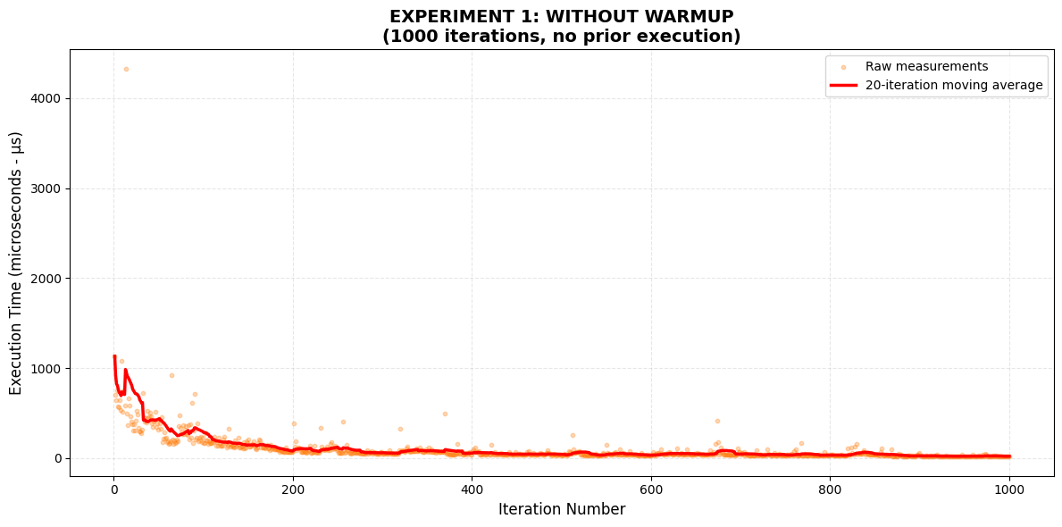
Impact of JVM Warmup on Results - Run 1

Slide 10
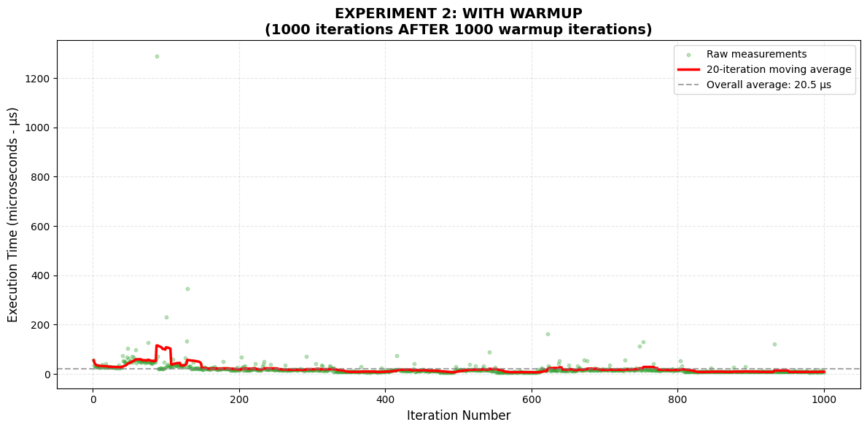
Impact of JVM Warmup on Results - Run 1

Slide 11
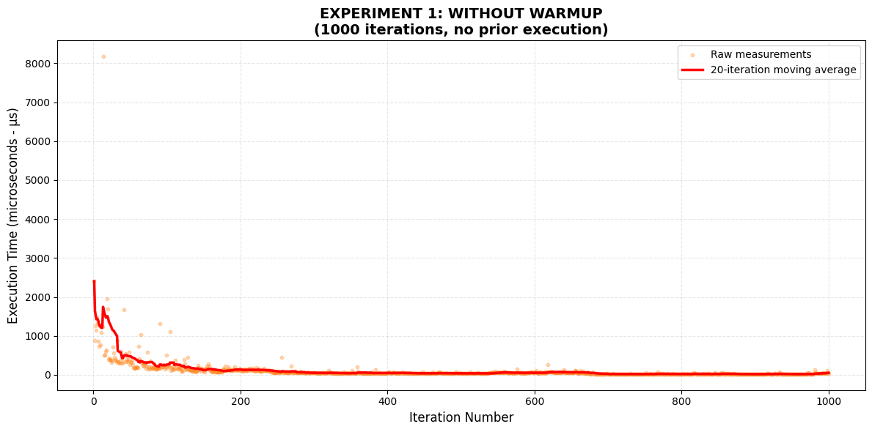
Impact of JVM Warmup on Results - Run 2

Slide 12
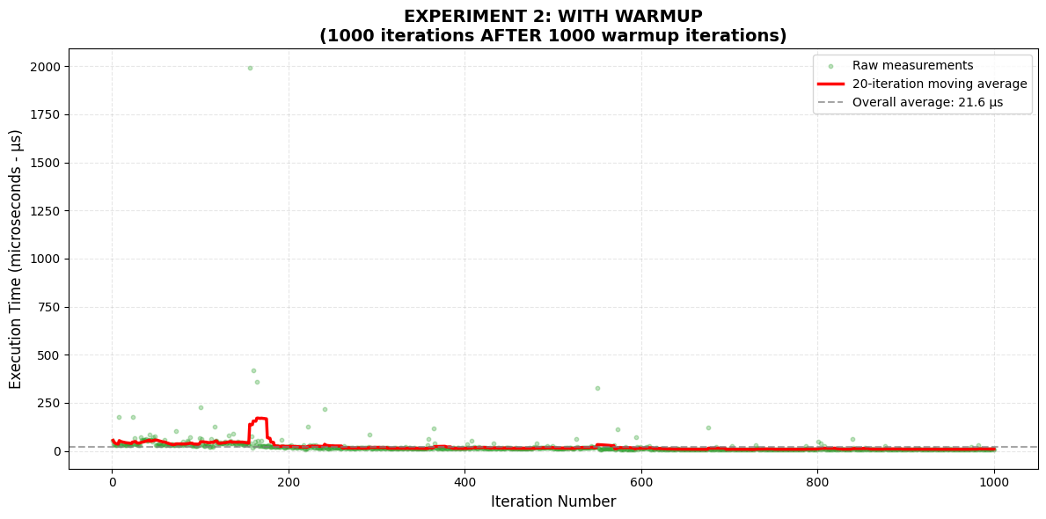
Impact of JVM Warmup on Results - Run 2

Slide 13
Computer Setup
Device: Lenovo5i
Operating System: Windows 11, 64-bit
Processor: 11th Gen Intel® Core™ i5-1135G7 @ 2.40GHz (2.42 GHz)
RAM Installed: 8 GB (usable: 7.56 GB)
System Type: 64-bit OS, x64-based processor
Key Libraries / Tools (Maven Dependencies)
Jackson Databind: 2.21.1
Protocol Buffers (protobuf-java): 4.33.5
JUnit: 3.8.1
Maven Plugins / Extensions
maven-compiler-plugin: 3.11.0 (source/target: 25)
protobuf-maven-plugin: 0.6.1
os-maven-plugin: 1.6.0
Notes:
Default JVM settings, no significant background processes.
All experiments run locally, single-threaded benchmark.

Slide 14
JSON vs Protocol Buffers in Microservice Serialization
Lucas Vilar & Bernardo Ventura
Thank you! Questions?

Slide 15
Full Benchmark Run 1 Results
JSON (Jackson) Small (5 items)
Serialization: 1,639.7 ns (σ = ± 7.8%)
Deserialization: 3,177.9 ns (σ = ± 7.7%)
End-to-End: 5,251.6 ns (σ = ± 11.9%)
Size: 656 B
JSON (Jackson) Medium (100 items)
Serialization: 31,944.5 ns (σ = ± 4.9%)
Deserialization: 66,272.6 ns (σ = ± 3.0%)
End-to-End: 98,734.4 ns (σ = ± 2.1%)
Size: 12.79 KB
JSON (Jackson) Large (10,000 items)
Serialization: 3,850,741.6 ns (σ = ± 2.1%)
Deserialization: 7,453,244.4 ns (σ = ± 3.9%)
End-to-End: 11,586,667.2 ns (σ = ± 3.4%)
Size: 1.27 MB
Protocol Buffers Small (5 items)
Serialization: 1,033.3 ns (σ = ± 6.7%)
Deserialization: 608.0 ns (σ = ± 5.0%)
End-to-End: 1,680.3 ns (σ = ± 3.0%)
Size: 356 B
Protocol Buffers Medium (100 items)
Serialization: 19,423.7 ns (σ = ± 5.1%)
Deserialization: 10,351.1 ns (σ = ± 4.8%)
End-to-End: 31,015.7 ns (σ = ± 2.3%)
Size: 6.92 KB
Protocol Buffers Large (10,000 items)
Serialization: 2,814,329.7 ns (σ = ± 13.7%)
Deserialization: 1,666,173.0 ns (σ = ± 13.0%)
End-to-End: 4,645,519.8 ns (σ = ± 12.6%)
Size: 714.00 KB

Slide 16
Full Benchmark Run 2 Results
JSON (Jackson) Small (5 items)
Serialization: 1,513.8 ns (σ = ± 2.8%)
Deserialization: 3,138.6 ns (σ = ± 4.2%)
End-to-End: 4,987.9 ns (σ = ± 8.4%)
Size: 644 B
JSON (Jackson) Medium (100 items)
Serialization: 31,636.5 ns (σ = ± 4.8%)
Deserialization: 66,304.8 ns (σ = ± 4.7%)
End-to-End: 102,044.7 ns (σ = ± 5.0%)
Size: 12.78 KB
JSON (Jackson) Large (10,000 items)
Serialization: 3,855,793.6 ns (σ = ± 5.9%)
Deserialization: 7,470,081.8 ns (σ = ± 5.3%)
End-to-End: 11,536,637.1 ns (σ = ± 3.4%)
Size: 1.27 MB
Protocol Buffers Small (5 items)
Serialization: 888.4 ns (σ = ± 10.3%)
Deserialization: 617.8 ns (σ = ± 12.6%)
End-to-End: 1,656.9 ns (σ = ± 10.2%)
Size: 343 B
Protocol Buffers Medium (100 items)
Serialization: 16,459.9 ns (σ = ± 2.5%)
Deserialization: 9,739.2 ns (σ = ± 2.0%)
End-to-End: 27,071.5 ns (σ = ± 1.4%)
Size: 6.90 KB
Protocol Buffers Large (10,000 items)
Serialization: 2,237,022.5 ns (σ = ± 13.3%)
Deserialization: 1,464,374.9 ns (σ = ± 18.6%)
End-to-End: 3,809,524.7 ns (σ = ± 12.9%)
Size: 714.01 KB

Slide 17
Full Benchmark Run 3 Results
JSON (Jackson) Small (5 items)
Serialization: 1,564.8 ns (σ = ± 3.1%)
Deserialization: 3,440.1 ns (σ = ± 1.0%)
End-to-End: 5,284.0 ns (σ = ± 1.4%)
Size: 646 B
JSON (Jackson) Medium (100 items)
Serialization: 32,466.8 ns (σ = ± 3.8%)
Deserialization: 63,441.0 ns (σ = ± 4.2%)
End-to-End: 98,558.9 ns (σ = ± 4.0%)
Size: 12.82 KB
JSON (Jackson) Large (10,000 items)
Serialization: 3,671,663.3 ns (σ = ± 1.4%)
Deserialization: 7,186,753.6 ns (σ = ± 1.6%)
End-to-End: 11,174,756.2 ns (σ = ± 0.8%)
Size: 1.27 MB
Protocol Buffers Small (5 items)
Serialization: 852.8 ns (σ = ± 3.6%)
Deserialization: 589.2 ns (σ = ± 3.2%)
End-to-End: 1,585.0 ns (σ = ± 1.5%)
Size: 344 B
Protocol Buffers Medium (100 items)
Serialization: 17,525.8 ns (σ = ± 4.4%)
Deserialization: 10,195.0 ns (σ = ± 4.1%)
End-to-End: 28,797.3 ns (σ = ± 2.6%)
Size: 6.94 KB
Protocol Buffers Large (10,000 items)
Serialization: 2,171,748.7 ns (σ = ± 2.7%)
Deserialization: 1,408,974.7 ns (σ = ± 2.3%)
End-to-End: 3,705,992.6 ns (σ = ± 3.4%)
Size: 714.41 KB

